Slide 1
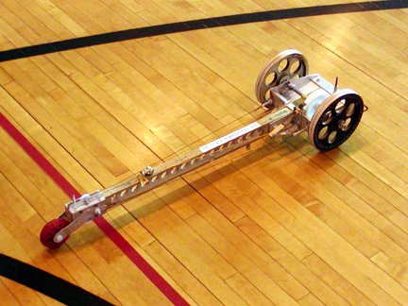
Wheeled Vehicle
Dennis Papesh
National Event Supervisor
dpapesh@holyangels.cc
Bro. Nigel Pratt
bronigel@kellenberg.org

Slide 2
TASK
Build a vehicle
Uses a non-metallic, elastic solid
Travels a distance quickly and accurately
Impound – yes
Eye protection - #5
Things are going to stretch – and possibly break

Slide 3
Construction Goals
Travel 7.00 m to 11.oo m
1.0 m increments – Regional
0.5 m increments – State
0.1 m increments - National
Does not stray from Center Line

Slide 4
Powered By
Non-metallic, elastic solid
Rubber bands, bent fishing poles, bungee cords, etc.
Must be impounded
Extra device may be impounded
Anything else used to power the device must start at lowest energy state
Pre-loaded energy storage devices may be used for other functions, such as braking system
May NOT be used to propel vehicle

Slide 5
Elastic Device
All materials are elastic to some extent
Must be a solid material
May not use metal to store energy
May consist of more than one part
Must be impounded with vehicle
Second elastic device may be impounded
May be left unattached until the run
Use simple machines to multiply distance it stretches or bends
May warp chassis if too strong or chassis too weak

Slide 6
Size - length
Distance between center of rotation of the front-most axle and rear-most axle must not be greater than 70.0 cm – don’t push the limit – responsible for much “Tier 3-ing!”

Slide 7
Length
¼ dowel
Dowel end to within 1 cm of the floor
70 cm

Slide 8
The Dowel & Measurement Point
Laser beam
Dowel end to within 1 cm of floor
30 cm 35 cm

Slide 9
Measurement Point
The front bottom edge of the ¼” dowel will be used this year as the Measurement Point
Must extend down to within 1.0 cm of the track’s surface
Responsible for most of the “down” tiering

Slide 10
Size - width
The entire vehicle at any point may not exceed 30.0 cm.
WARNING: Be careful of axle ends. These are often ignored when measuring, but they must be within the 30.0 cm max limit.
Don’t push the limit – responsible for much “down” tiering

Slide 11
Part(s) exchange
Once impounded, only the elastic solid (with any connected attachment device) or aligning device, may be removed or added to the vehicle

Slide 12
Trigger
Must use an unsharpened #2 pencil with an unused eraser (provided by the Event Supervisor)
Must be designed so that actuation is perpendicular (vertical) to the floor
Non-vertically actuated trigger is a Construction Violation
Students must not hold, constrain, or push vehicle
Must be able to remain at starting position without being touched until triggered

Slide 13
Contact with floor
Only the wheels and drive strings, if any, may contact the floor at any time
If a piece falls of the vehicle during the run, it is a Construction Violation

Slide 14
Brakes
Stopping mechanism must work automatically
Must not be remotely controlled or tethered
Most common braking system
(Axle and wing nut -
http://www.youtube.com/watch?v=RJwFtkFSuJM)

Slide 15
Electrical
No electrical or electronic devices can be used on the vehicle, its sighting/alignment devices or any tools
With the exception of any type of calculator

Slide 16
The track
Smooth, level, and hard surface (or whatever they give the Event Supervisor)
It is recommended that at least 0.5 m is provided on both sides of the Center Line (a bit more is better)
Tape used for Center Line, Starting Line, 0.5 m line, 6.5 m line, and Target Line
Target line will be marked with a point on the inside edge where the Target Line meets the middle of the center line.
Photo gates, if used, will be placed between 30.0 cm and 35.0 cm from the floor (rule 3.e)

Slide 17
The Track
Lasers
0.5 m line
6.5 m line
Target line
Start Line
7 m - 11 m

Slide 18
Competition - Impound
Vehicle and interchangeable parts
Tools, test date, measuring/calculating devices used to make adjustments need not be impounded
Power tools requiring an electrical outlet must not be allowed

Slide 19
Competition – outside help
Once competitors enter the event area to compete, they must not leave the area or receive outside assistance, materials, or communications until they are finished competing.
All assistant coaches and parents should be made aware of this and reminded often.

Slide 20
Event Time – 8 minutes
Can measure distance if desired
Load energy into vehicle
Make up to 2 runs
May adjust vehicle between runs
e.g. Change speed, distance, directional control, changes from impounded parts
Event Supervisor measurement time does not count in these 8 minutes

Slide 21
Measurement
Teams may use their own measuring device to measure track or the distance from the Measurement Point to the line - as part of their 8 minutes
May not roll the vehicle on or adjacent to the track at any time prior to or during the competition
May not roll the vehicle from where it stopped to the finish line to establish correction – may measure though
May be a way to preset the braking system

Slide 22
Sighting/aiming devices
Sighting and aiming devices may be placed on the track but must be removed before the vehicle begins to run
Aligning and sighting devices mounted on the vehicle may be removed at team’s discretion prior to each run

Slide 23
It goes down the track
Competitors must not follow
Must wait until called by Event Supervisors
8 minute timing begins again when they pick up the vehicle
May do own measurements but it is part of their 8 minutes

Slide 24
What happens if?
No movement- students may ask for another try at same run – their 8 minutes – ask the Event Supervisor before touching the vehicle – Not counted as a run
Vehicle veers and does not pass through photogate or cross the 6.5 m line
Tier 2 – time measured by timing persons, distance measured
Vehicle passes 0.5 m line but not the 6.5 m line
Tier 2 – time measured by timing persons, distance measured

Slide 25
What happens if?
Time and/or distance cannot be measured
Starts before Event Supervisor is ready
Moves but does not go at least 0.5 m
Competitors pick it up before it is measured
Travels in wrong direction
The run is considered a Failed run.

Slide 26
Scoring
Score = Time Score + Distance Score + Center Line Bonus
Time Score = Run Time x 5 where Run Time is the time between the 0.50 m line and 6.50 m line
Distance Score = distance from Measurement Point to Target Line in centimeters to the nearest 0.1 cm
This is a point to line measurement

Slide 27
Scoring
Center Line Bonus
-20 points if the center line remains completely within the vehicle’s track while vehicle travels between the Start Line and the Target Line.
Awarded even if the tip of the fixed point or entire vehicle crosses the Target Line
Final Score = run which gives team the better rank
Tie breakers
Better non-counted run
Faster time on the counted run

Slide 28
Tiers
Tier 1 – run with no violations
Tier 2 – run with competition violations
Tier 3 – run with construction violations or both construction and competition violations
Tier 4 – any vehicle not impounded
Teams who cannot complete a run or have 2 Failed runs will be given participation points

Slide 29
That was the easy part
Now that we’ve covered the rules, we get into how to build one of these.
Many of the following photos come from my old Mousetrap Vehicle as there are many similarities in construction, so ignore the mousetraps.
Many slides came from the 2007 powerpoint of Erv Zimmerman

Slide 30
Body / Chassis
Connects all of the other parts/systems together
Determines wheelbase
longer wheelbase means it is easier to keep vehicle in the lane
May provide more room to ‘stretch’ the elastic material

Slide 31
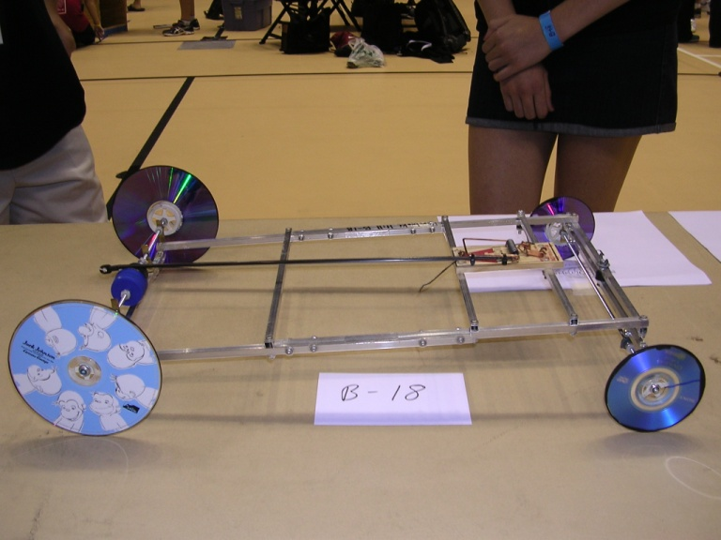
Wide Chassis
Wide chasses tend to go straighter.
Can add more weight.
Would make it easier to get the center line bonus.
Adds additional stress to powered axle.

Slide 32
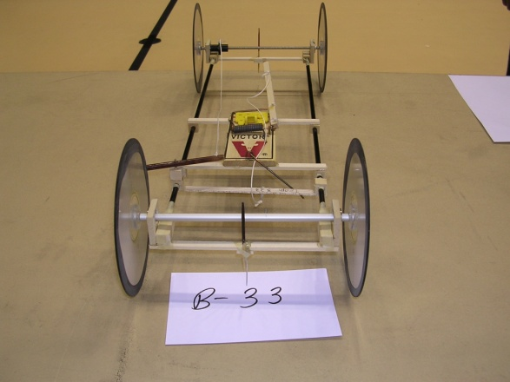
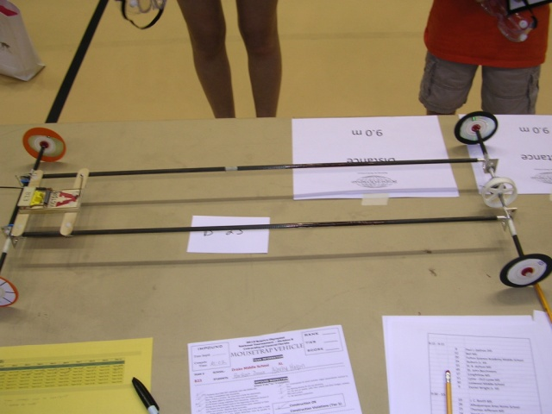
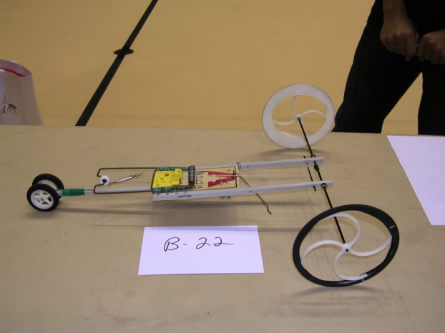
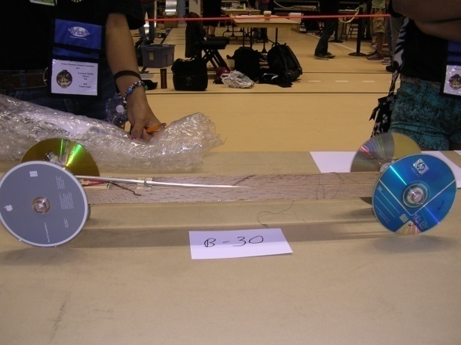
Chassis
Almost no chassis –frame has few, thin members – this can help make a very light vehicle.
Should increase speed due to lower mass to move.
Easy to warp.

Slide 33
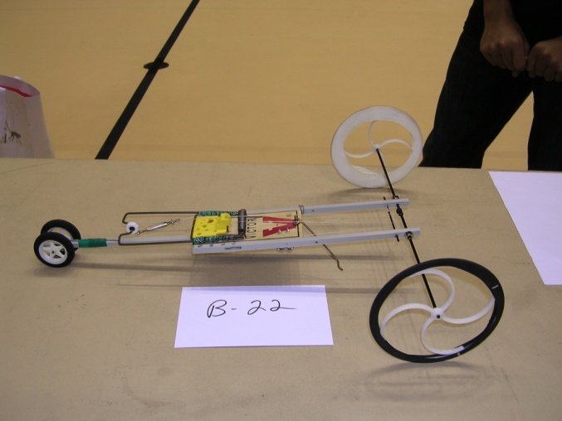
Narrow Chassis
Very lightweight
May be difficult to run a straight line.

Slide 34
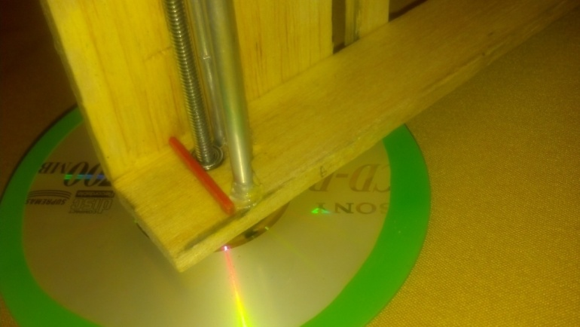
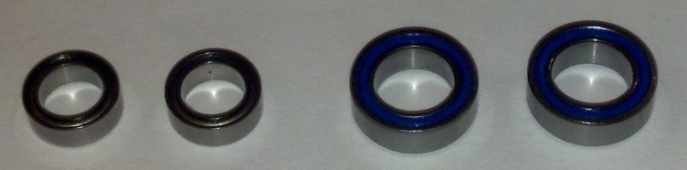
Axle
Axle has a ball bearing insert where it passes through chassis to reduce friction.
Thin axle will bend under stress.
Can be purchased in many sizes from local RC (radio control) stores or hobby shops.

Slide 35
Wheels and Axles
Wheels are difficult to make exactly round
Large diameter Wheel
Revolves fewer times to travel a given distance.
Vehicle travels faster
Requires stronger elastic
Elastic needs to stretch/bend less
Heavier
Optimum size is somewhere in between

Slide 36
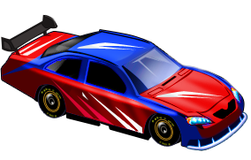
Wheels
It takes energy to turn a wheel
The greater the mass of the wheel, the more energy it takes to turn it
So
Use smaller wheels
If possible, cut or drill mass out of wheels
Especially out near the rim of the wheel
Use lighter materials
3 inches or less is good but

Slide 37
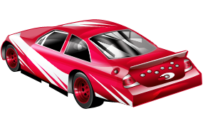
Wheels
Smaller drive wheels = greater speed
May spin out on take-off
Larger drive wheels = greater distance
May be too heavy for decent speed
Must balance the two to get the 11 meters if that is the length of the track
Remember – speed for 0.5 to 6.5 meters, then accuracy

Slide 38
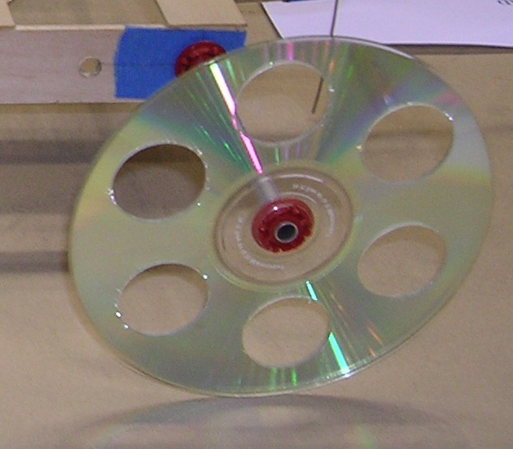

Wheels
CD – size can add mass requiring more energy
Drilled holes reduce the mass, getting a better effect from the elastic material’s energy
Even if smaller CD wheels used, think about removing some mass out near rim.

Slide 39
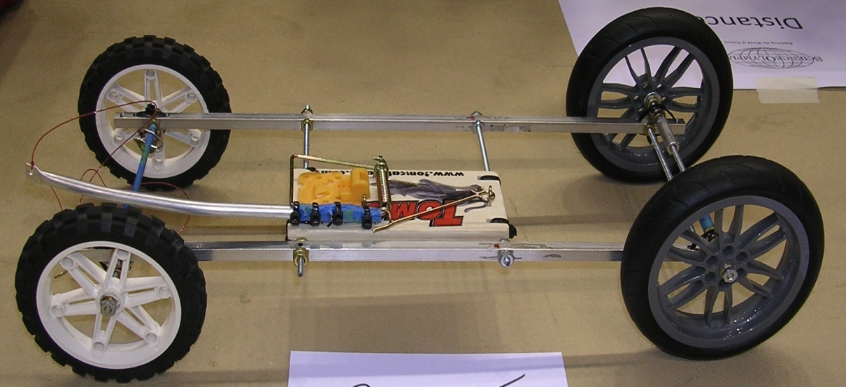
Wheels
Very light chassis, fragile
Large, heavy wheels add mass and take a lot of energy to turn

Slide 40

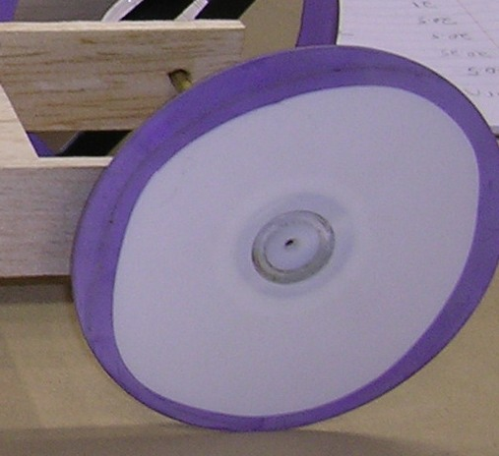
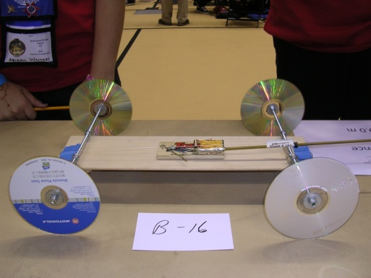
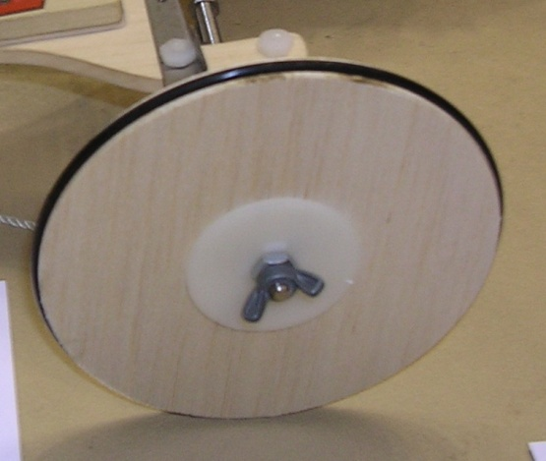
Wheels - Friction
The wheels will tend to spin without grabbing floor unless the friction is increased between the wheel and floor.
Wheels to left are bare and may not give a good start as they might spin.
Wheels to right have something added to increase friction – often a stretched balloon.

Slide 41
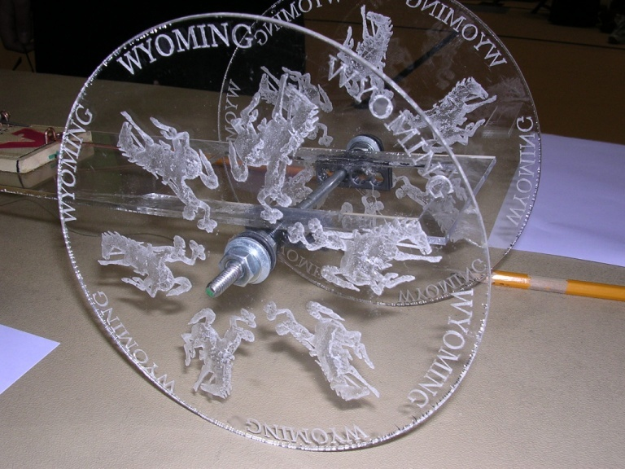
OK, so maybe it is just a tidge big and heavy, but it sure is beautiful.

Slide 42
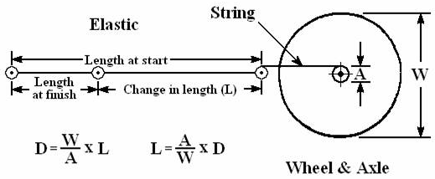
How Far Will It Go?
1. Divide diameter of the wheel (Output) by diameter of the axle (Input) to get the IMA of the Wheel & Axle.
2. Multiply the length the elastic changes (L) by the IMA of the Wheel & Axle to find the distance your vehicle will travel.
3. To calculate how much the elastic must change to travel the Target Distance (10 meters), divide 10 meters by the results found in step #1.

Slide 43
“Transmission”
Use IMA of simple machines to “multiply” the stretch of the elastic so the vehicle can go the Target Distance
Example uses a “Wheel & Axle”
String wrapped around the axle transfers the energy
Remember to convert all dimensions to the same units.

Slide 44
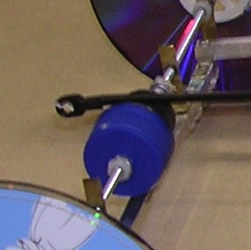
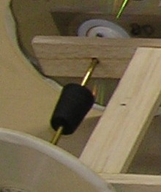
Gearing
Jump start off the larger axle and then build up speed by switching to a smaller diameter axle.

Slide 45
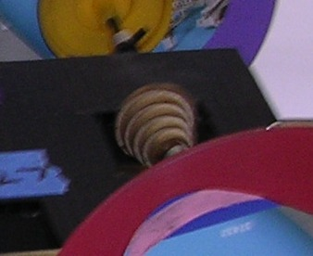
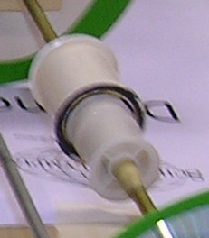
Gearing
Somewhat fancier
Somewhat simpler, with up to four levels

Slide 46
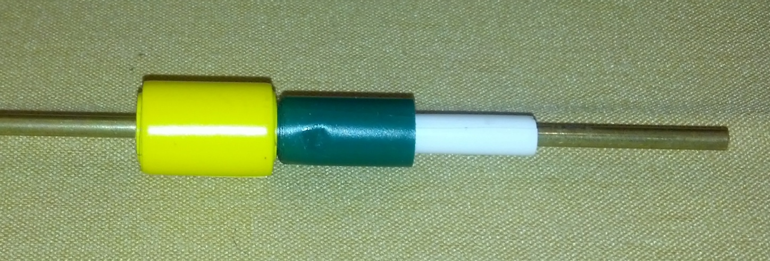
Gearing
A simple practice axle to determine the amount of raise you wish to add to the axle and the width of the different levels.

Slide 47
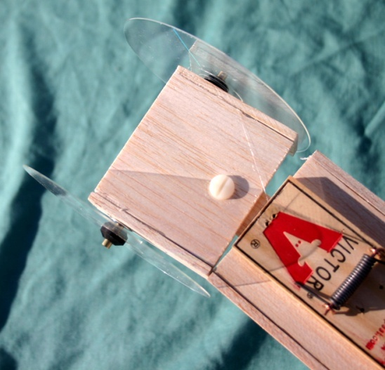
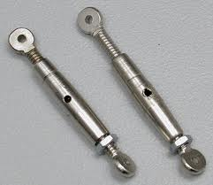
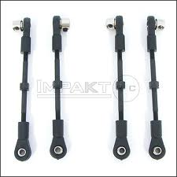
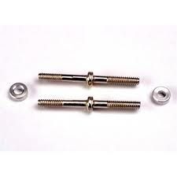
Steering
Difficult to keep properly aimed.
Good way to make small, but lasting changes

Slide 48
Lengthen out one or two slots on long arm of chassis right beneath axle attachment.
Attach one end of turnbuckle to long arm of chassis and other to axle.
Can make minor but lasting changes to angle of travel.

Slide 49
Distance Measuring
Usually implemented by counting turns of wheels.
May have scale marked on circumference of wheels.
May apply brake

Slide 50
Brakes
None – Coast to a stop
Easy to implement
Distance unpredictable
Positive Lock
Easier to make
May cause wheels to skid and distance to be unpredictable.
Always stops in the same position.
Combine with friction type for best results.
Friction – Gradual application
Difficult to make
Prevents wheel skid
Final stopping position unreliable
Combine with positive lock for best results.

Slide 51
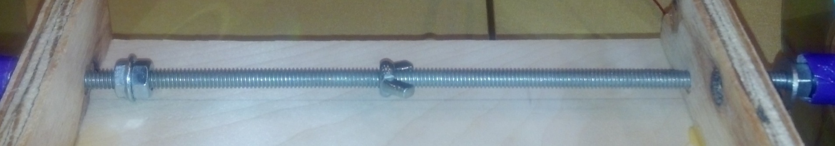
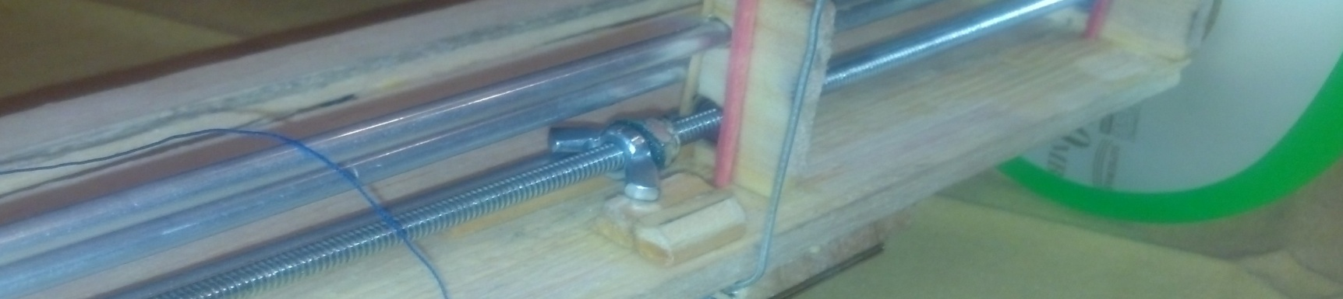
Braking
Bobby’s 2nd car – brake would apply itself in center of vehicle to avoid a pull to one side
Bobby’s 1st car – brake would apply itself on one side of the vehicle and cause a change of direction.

Slide 52
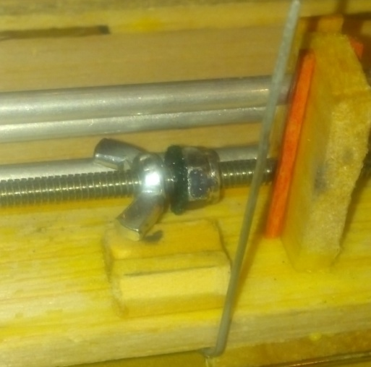
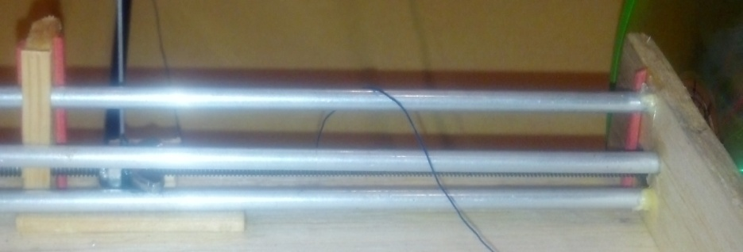
Braking
Small felt pad to absorb some of the shock of braking.
Wing nut rides between two rods to eliminate shaking and to help ensure accuracy.

Slide 53
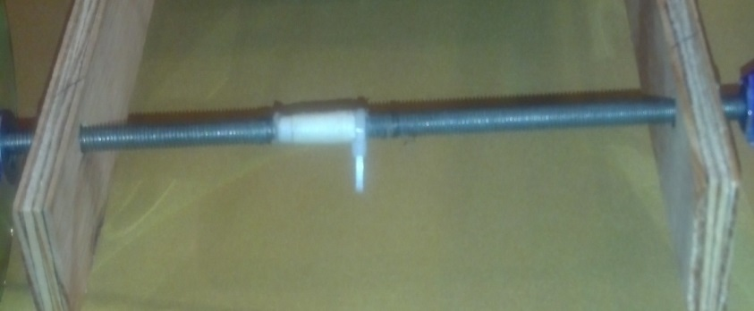
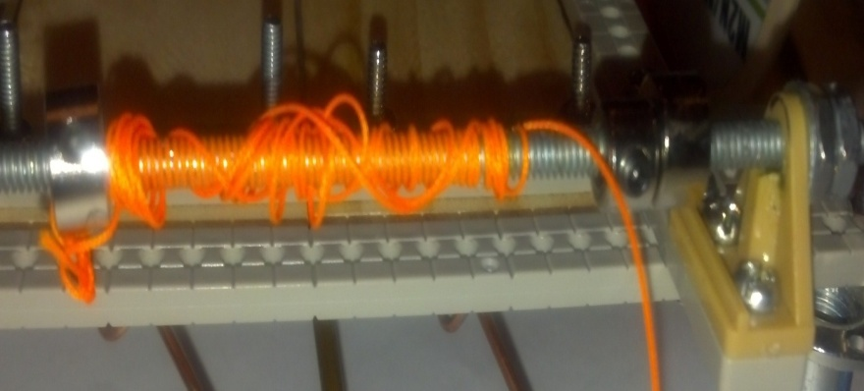
Elastic attachment
Some students wish the elastic to come free when it has expended its energy and need to make arrangements to allow the string to slide off and vehicle to coast. What is shown here was fine for Mousetrap but probably will not be strong enough for Wheeled. (But the idea is a starting point.)
Others have enough elastic on the axle to allow the vehicle to coast without the elastic coming free. Possible problem - elastic entangle-ment which stops the vehicle short.
Perhaps a drop of CA glue to keep the zip-tie from slipping.

Slide 54
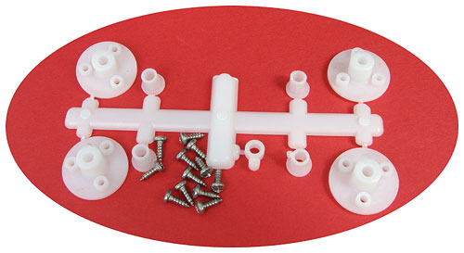
Products
Pitsco
W24642

Slide 55
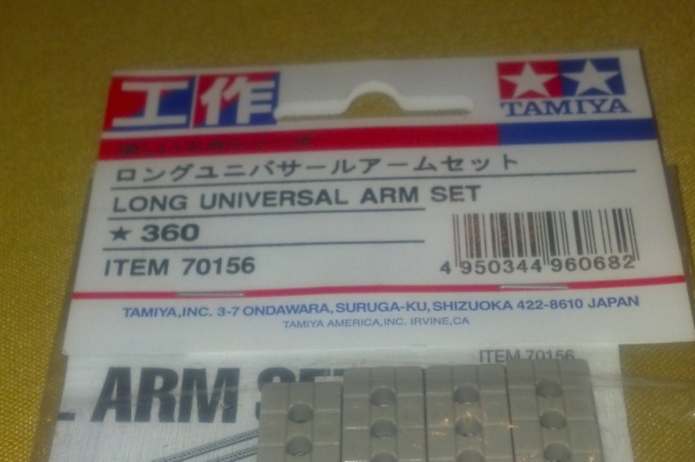
Products
Tamiya - 70156

Slide 56
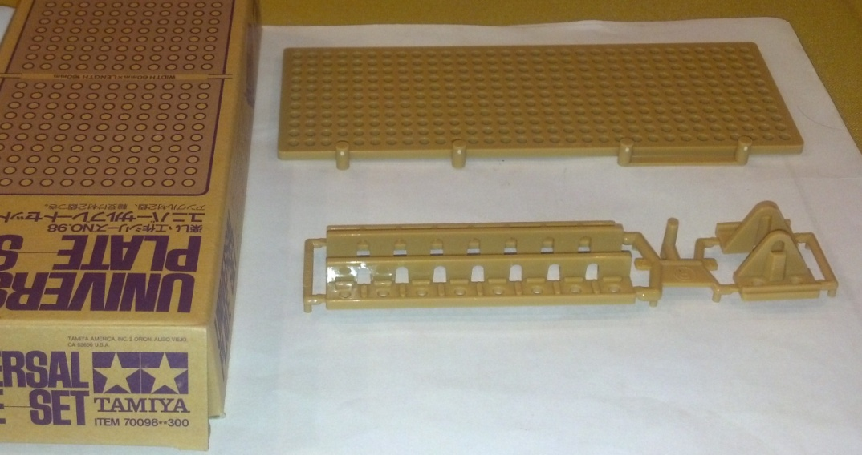
Products
Tamiya - 70098
Patrick used this part to attach axle to the frame. He felt that the frame bed shown above was too heavy to allow good speed.

Slide 57
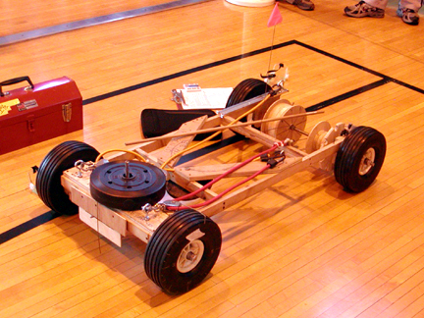

Slide 58
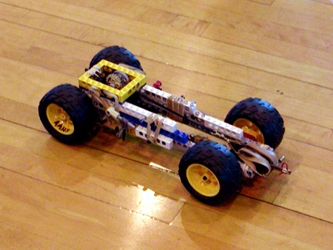

Slide 59
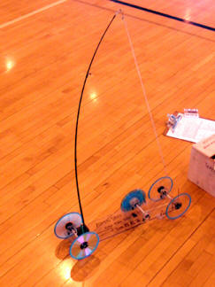

Slide 60
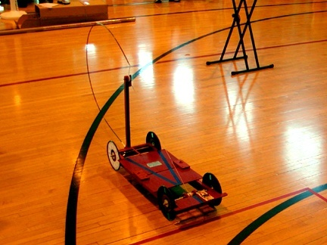

Slide 61
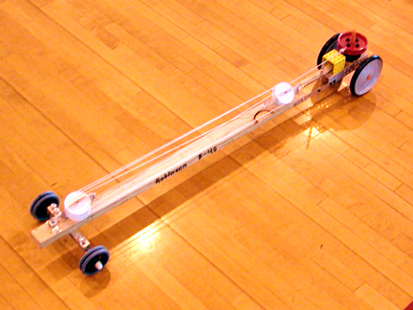

Slide 62
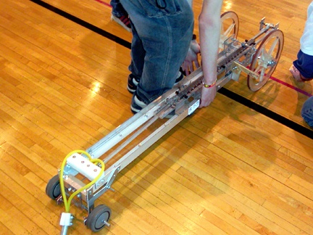

Slide 63
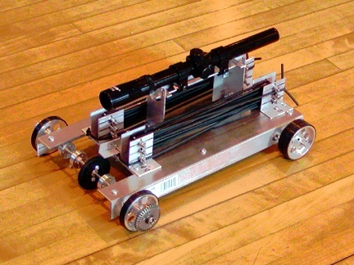

Slide 64
And now, “it’s off and thinking”

